Slide 1
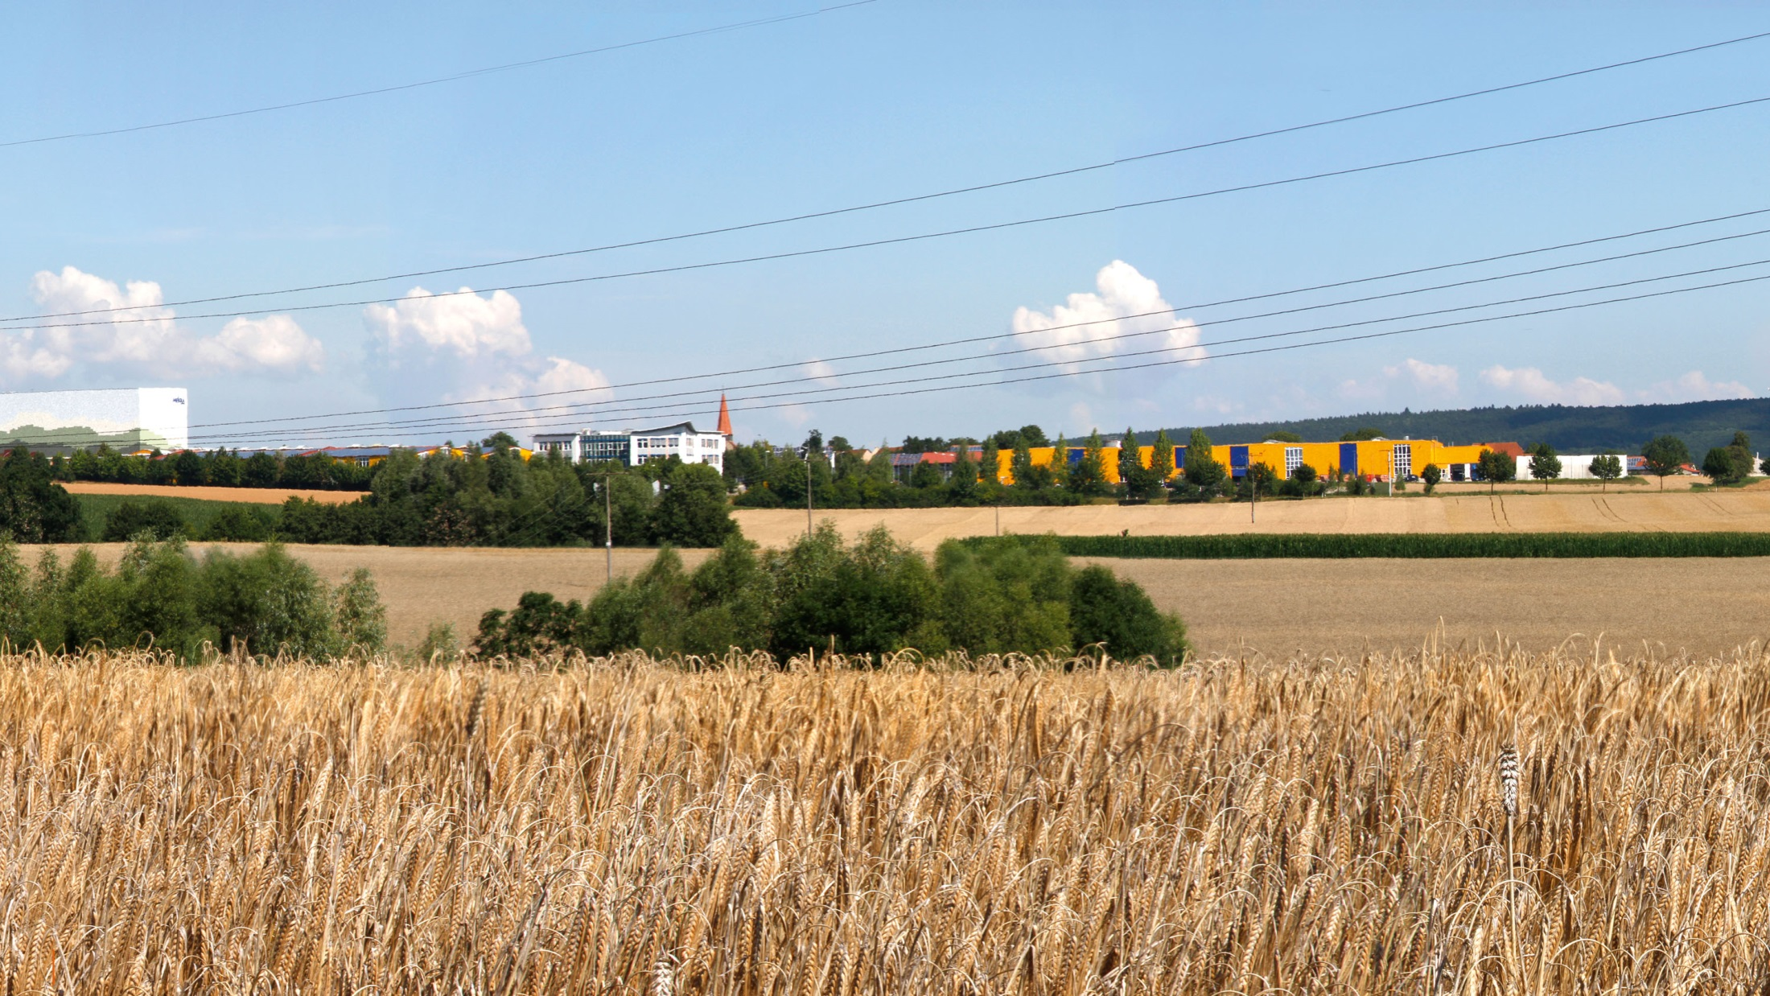
SOW 2
Delay Measurement

Slide 2
SOW 2
Delay Measurement
  Premise:
  How can we measure the time it takes for the ECU to process the incoming image data and send it to the vehicle?
  Compare with Safety Goal 1

Slide 3
SOW 2
Delay Measurement
  Objective from Safety Goal 1:
  The delay must be less than 50ms
  The delay is to be measured as follows:
  From the start of a frame at the input to the start of the frame at the output OR, equivalently, e.g. from end to end

Slide 4
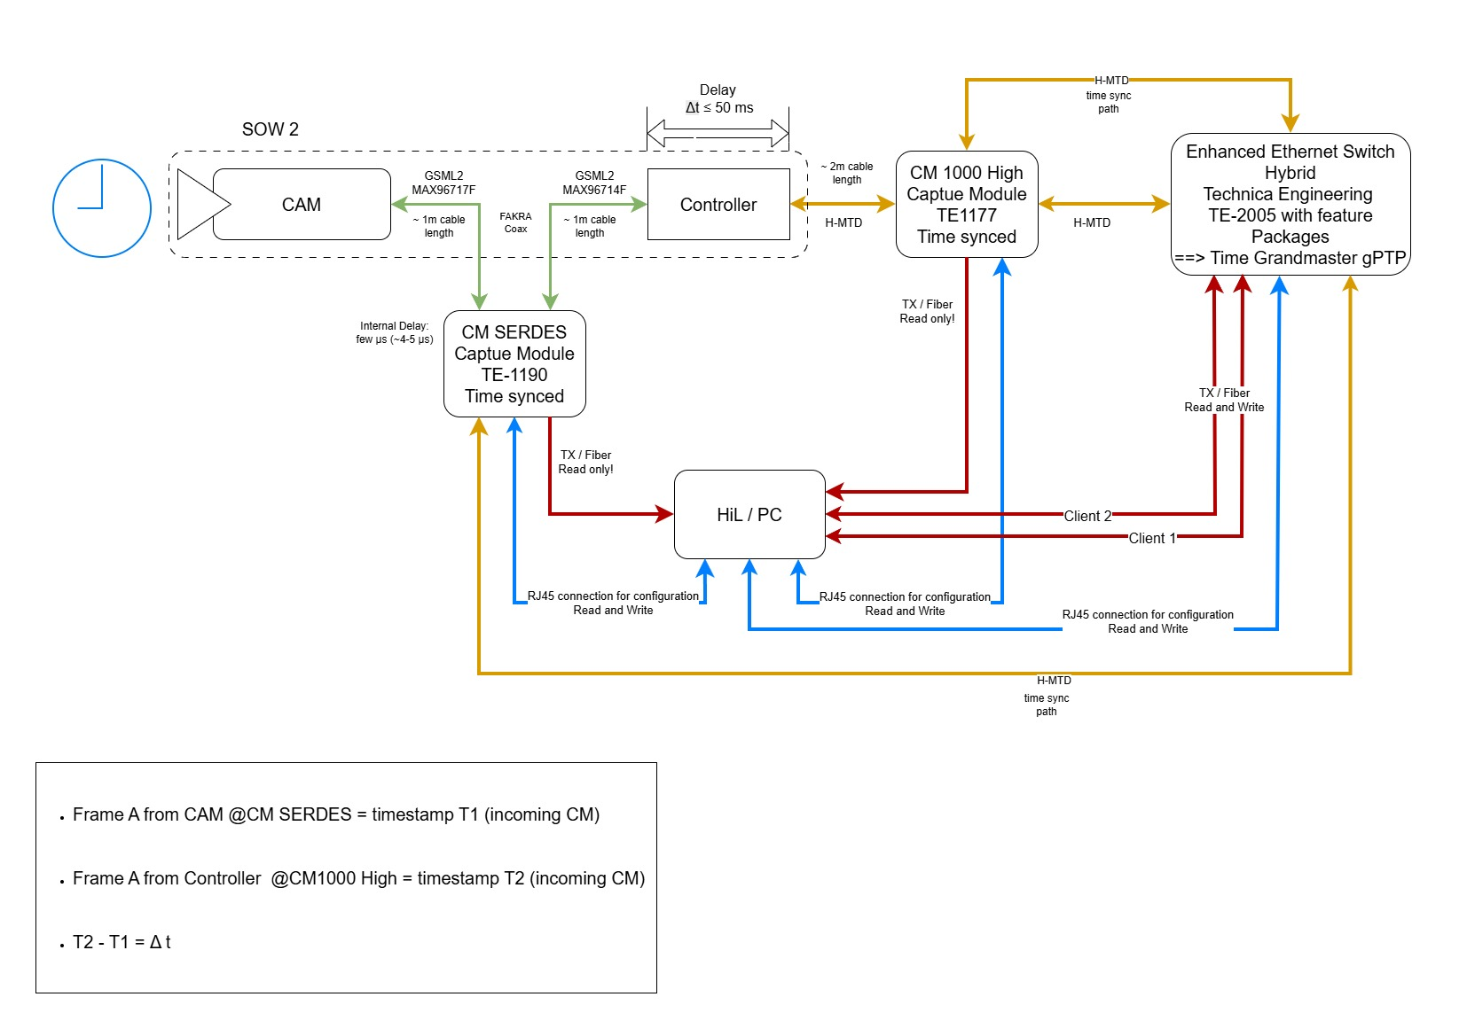
SOW 2
Delay Measurement - Schematic diagram of setup

Slide 5
SOW 2
Delay Measurement - How It Works
Latency Measurement Setup:
GMSL2 stream tapped between SOW 1 and ECU via the CM SerDes capture module (tap mode)
Incoming packets are timestamped and stored on the PC/HIL
ECU processes the data and re-outputs it as an RTP stream
RTP stream is timestamped by the CM1000High capture module and stored on the PC/HIL
Both capture modules are time-synchronized via the same gPTP grandmaster
A trigger event visible in the video stream links both traces → enables time-difference (latency) calculation

Slide 6
SOW 2
Delay Measurement - Prerequisite:
  The software must configure the imager to generate a defined event:
  Switching from a live image to a test image for example.
  Here, the switch is used as the event to link the two traces together.
  Framerate Imager and Framerate RTP-Stream identical.

Slide 7
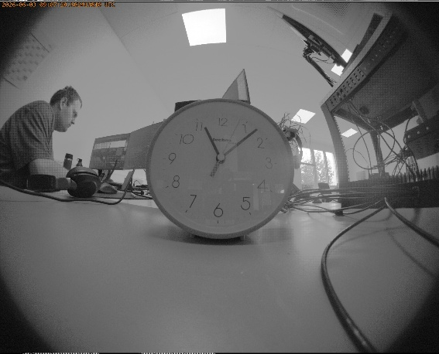

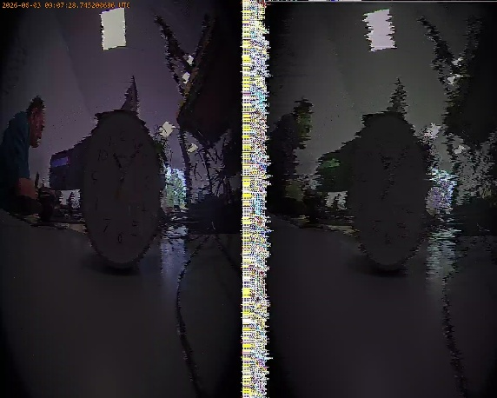
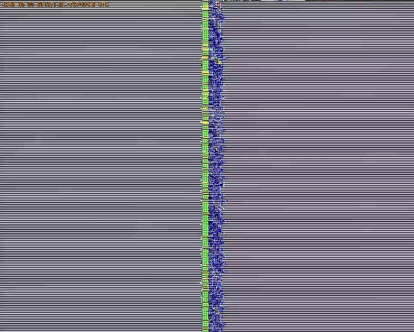
SOW 2
Delay Measurement - Switch from liveview to testimage triggered
CM SerDes
CM 1000 High

Slide 8
SOW 2
Delay Measurement - Results
Match: | Timestamp frame CM SerDes [ns]: | Timestamp frame CM 1000 High [ns]: | Latency [ms]:
1 | 1780477730622727242 | 1780477730328733618 | 293,9
2 | 1780477730655711294 | 1780477730362017498 | 293,6
3 | 1780477730689225451 | 1780477730395301546 | 293,9
4 | 1780477730722320683 | 1780477730428586546 | 293,7
Measurments were done on June 11th 2026 on B2 Devboard with DevDrop: SW03Z14
For repetion the SW must meet the Prerequisite mentioned on page 6.

Slide 9
MEKRA Lang GmbH & Co. KG
Buchheimer Str. 4
91465 Ergersheim
Tel +49 9847 989-0
Fax +49 9847 989-200
www.mekra.de
www.mekratronics.de
www.karriere.mekra.de
Validierung Elektronik
Type of company:
Kommanditgesellschaft (limited commercial partnership). Registered office: 91465 Ergersheim
Company registration number at the Fuerth registry court (Registergericht): HRA 4064
Personally liable partner: Lang Verwaltungsgesellschaft mbH. Registered office: 90768 Fuerth
Company registration number at the Fuerth registry court (Registergericht): HRB 533
Managing Directors: Susanne Lang, Bernd Dehner, Thomas Kolodziej

